Slide 1

Free Python and Django workshop
for women in Brno, February 2015

Slide 2
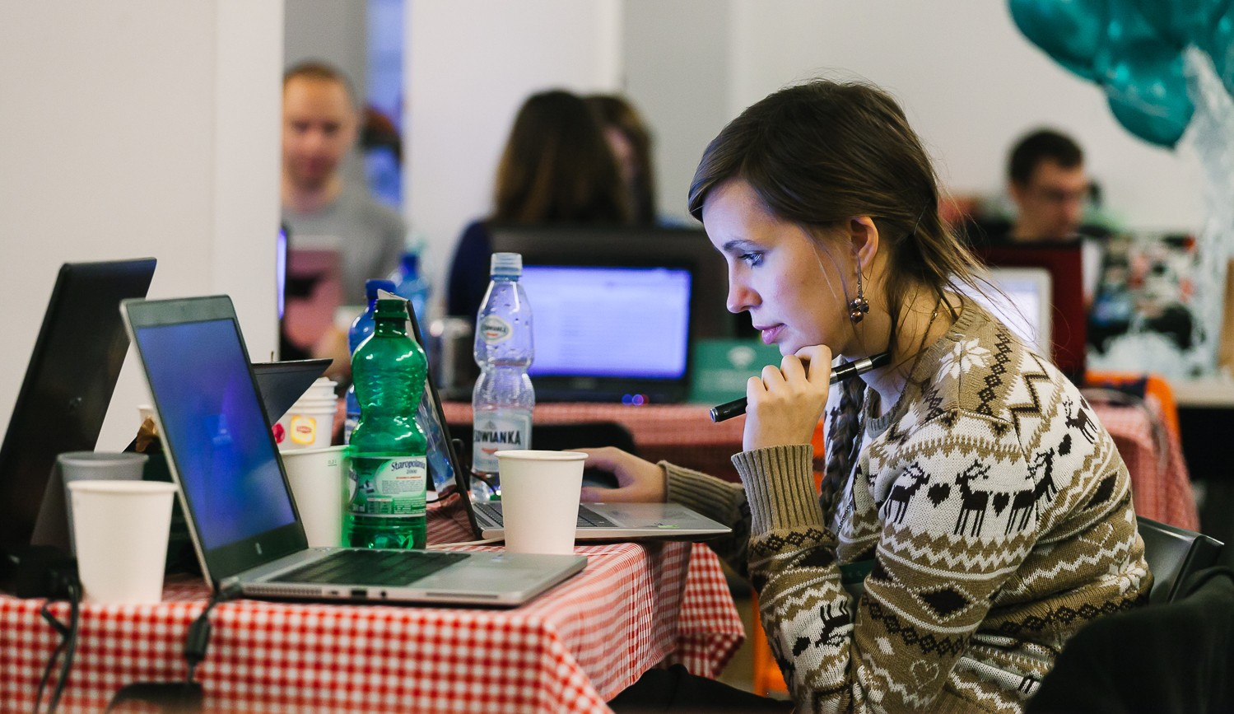
About
5th February 2014
Brno, Czech Republic
Django Girls is an initiative that is aiming
to introduce 30 women who've never coded before to the world of technology and increase the diversity. Right before DevConf.cz 2015 in Brno, we’re going to organize an one-day workshop and invite girls from all over Europe to join us and learn how to build the internet using HTML, CSS, Python and Django.

Slide 3
Target
Date & place
Supporters
30 women who never programmed before but are motivated to get into field, and who would share their experience with others
Full day, 5 February 2015
Brno University of Technology, Faculty of Information Technology
(hosted in the Red Hat office at the university)
We have already partnered with 10 awesome coaches, DevConf.cz, and Red Hat Czech!

Slide 4
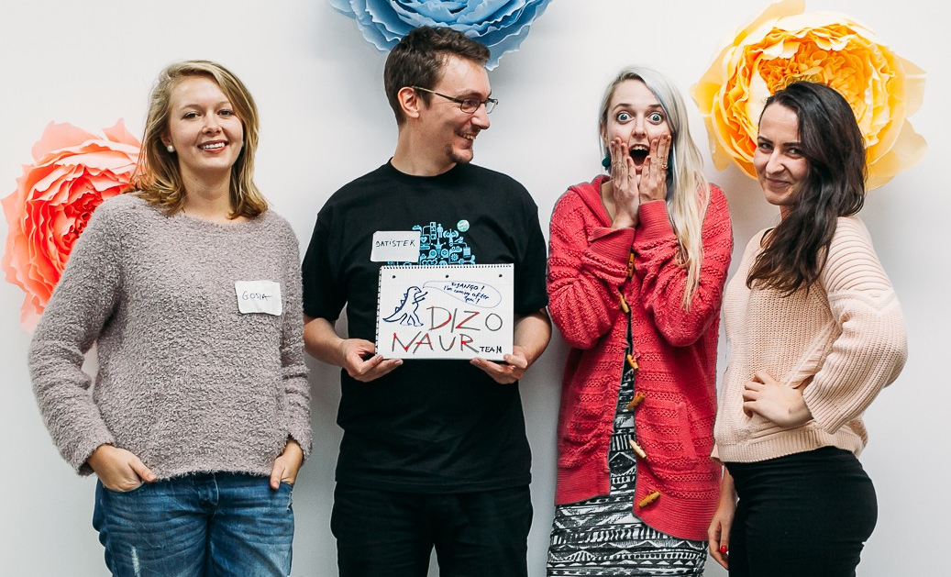
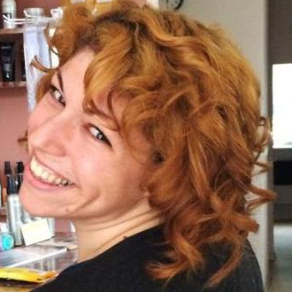
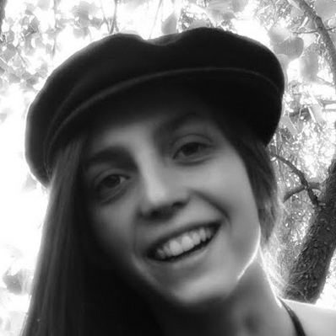
Team
Django Girls Brno is organized by Mikey Ariel and Lenka Moutelíková from Brno. Mikey and Lenka both graduated from the first Django Girl workshop at EuroPython 2014, and they are excited about sharing what they learned and giving other women the same opportunity that they were given!
@thatdocslady
@enigmatahari

Slide 5

SPREAD THE WORD!
We’re looking for kind souls and organizations that support the goal of bringing more women into technology to help us.
Reaching to the local communities is the most effective way to encourage women to try out programming. Many women simply have no idea that they can pursue these fields, and among those who do, many women do not feel that they are deserving or capable of trying it out.
Our goal is to change this mentality, help women conquer their fears and give them a friendly, inclusive, and supportive environment to explore the world of technology.

Slide 6
SPREAD THE WORD!
Here are some ways you can help:
Face 2 Face
Website/Email
Social Media
Mention our workshop to all the women you know!
Share the workshop at your local meetup / company meeting
Write about us on your website
Send an email to your community or employees
Follow/retweet @djangogirlsbrno
Blog about us
Share our website on Facebook and Google+

Slide 7
Thank you! ♥
djangogirls.org/brno
@djangogirlsbrno
Get in touch:
brno@djangogirls.org

